Slide 1
Breast Cancer Diagnosis from Fine Needle Aspirates With Naïve Bayes, K-means and Multi-layered Neural Network Classifiers
Presented by
Nazli Ensafi - 40038607
Victor Tobar - 40042766
Radley Carpio - 40074888
Concordia | December 2022

Slide 2
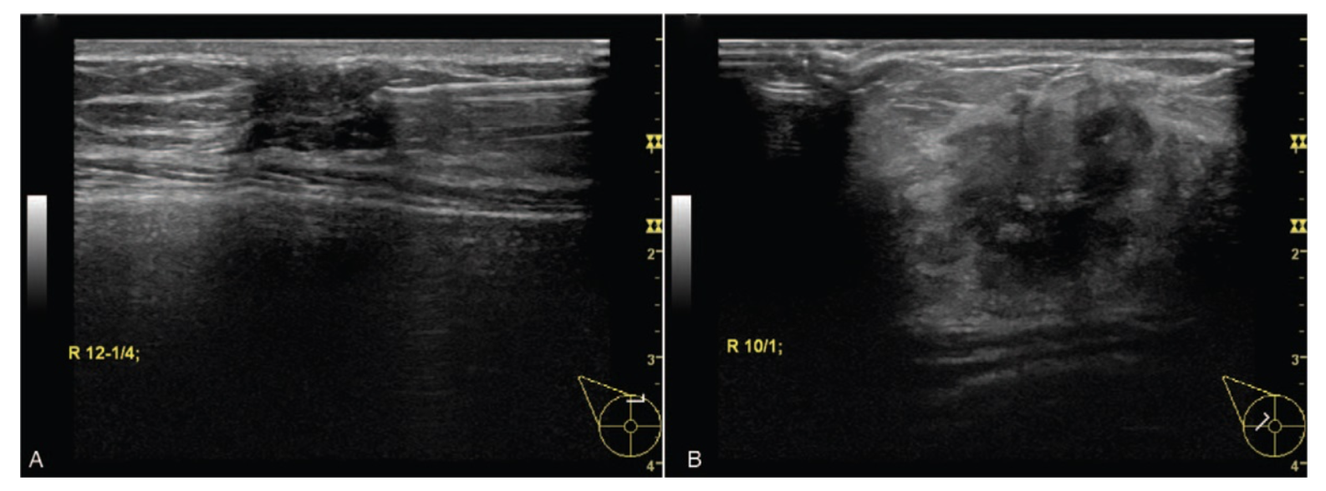
Detection and classification the breast tumors using mask R-CNN on sonograms^{[1]}
By Chiao, Jui-Ying BS; Chen, Kuan-Yung MD; Liao, Ken Ying-Kai MEng; Hsieh, Po-Hsin BS; Zhang, Geoffrey PhD; Huang, Tzung-Chi PhD.
Motivation behind using sonograms is that they are less intrusive.
Dataset consists of 307 sonograms (720 x 960) split in 80% training and 20% testing data.
Overall classification accuracy of 85%.

Slide 3

Breast Cancer Diagnosis from Fine Needle Aspirates With Naïve Bayes, K-means and Multi-layered Neural Network Classifiers
Split the dataset identically for all classifiers.
Use metrics to compare performance of our classifiers.
Metrics include:
Accuracy
Precision
Recall
False negatives
F1

Slide 4
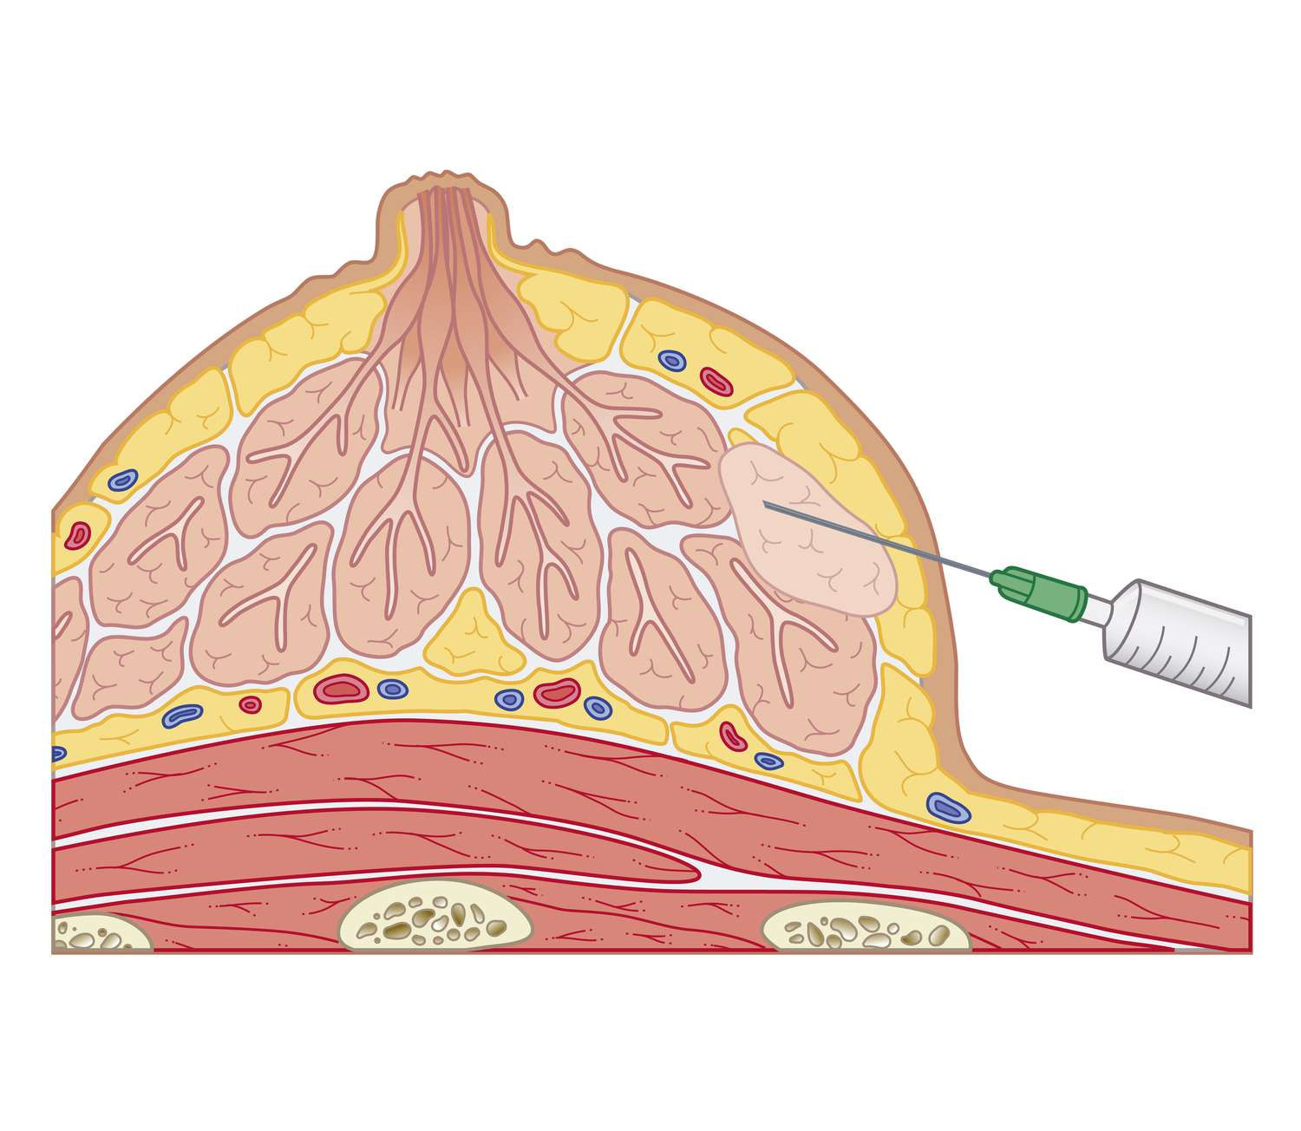
Fine Needle Aspirate (FNA)
Type of biopsy that uses a very thin needle and syringe to remove a sample of cells from an irregular area or lump in the body.
Cells are then examined under a microscope for diagnosis.

Slide 5

Data
Breast Cancer Wisconsin (Diagnostic) Data Set.
By Dr. William H. Wolberg, General Surgery Dept. University of Wisconsin.
569 labeled samples along with their feature values.

Slide 6
Features
Sample features are computed from a digitized image of a FNA of a breast mass.
Ten real-valued features are computed for each cell nucleus
Radius
Texture
Perimeter
Area
Smoothness
Compactness
Concavity
Concave points
Symmetry
Fractal dimension

Slide 7
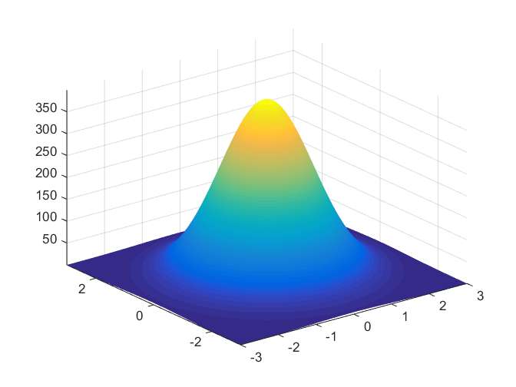
Naïve Bayes
Gaussian Naïve Bayes.
Why Naïve Bayes?
Simple yet powerful.
Works well for a wide range of real-world classification problems.
Why Gaussian Naïve Bayes?
Feature values in our dataset are continuous.
How does it differ from basic Naïve Bayes:
Gaussian Naïve Bayes assumes that each class follows a Gaussian distribution.

Slide 8
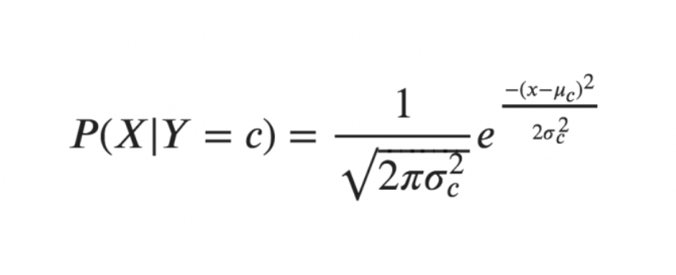
Naïve Bayes
How it works:
For simplicity, assume there are only two features.
Calculate the priors.
Calculate the mean and the variance of each feature of each class.
To classify a sample, calculate the posterior probabilities of each class.

Slide 9
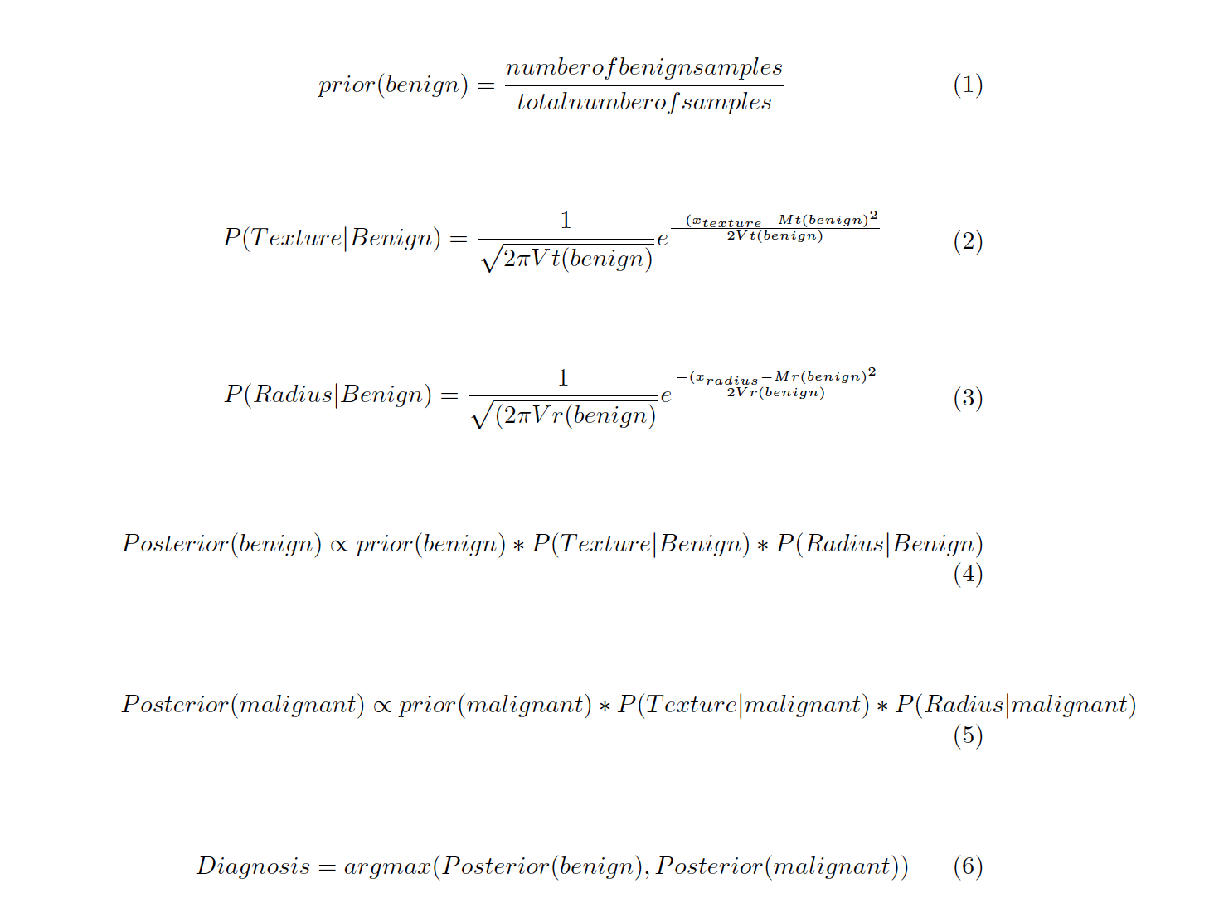
Making a Prediction with Naïve Bayes
Class | Mean (texture) | Variance (texture) | Mean (radius) | Variance (radius)
Benign | Mt(benign) | Vt(benign) | Mr(benign) | Vr(benign)
Malignant | Mt(malignant) | Vt(malignant) | Mr(malignant) | Vr(malignant)

Slide 10
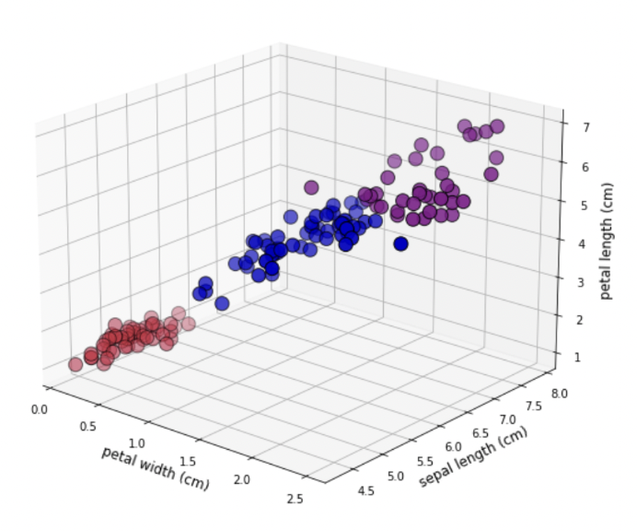
K-Means Clustering
Simple and intuitive approach to clustering
Computationally cheaper than other clustering algorithms
Clustering helps find new categories in the classes
We hope that if we set k to be equal to the number of classes in our supervised learning data, the clusters will naturally belong to our predetermined classes

Slide 11
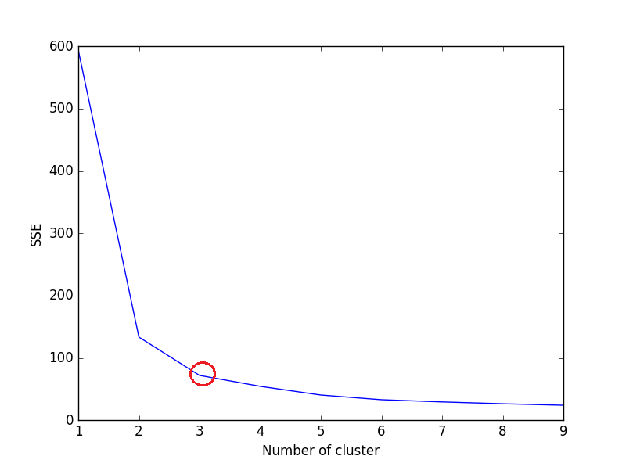
K-Means Clustering
Sum of Squared Error (SSE) and number of clusters (k) are closely related
More adding more clusters reduces SSE, but after a certain point the reduction is minimal
An ‘elbow’ graph is used to determine the optimal k

Slide 12
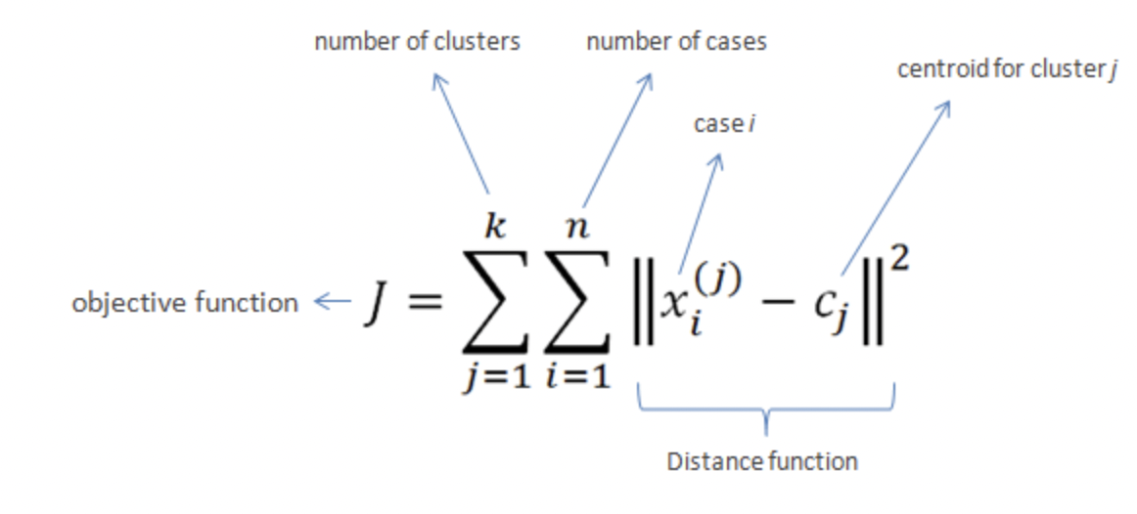
K-Means Clustering
How it works
Centroids are initialized to random samples
Every sample is assigned to the cluster with the nearest centroid
New centroids are calculated as the mean of every sample in that centroid
Repeat steps 2 & 3 until all samples remain in the same cluster after updating the centroid mean

Slide 13
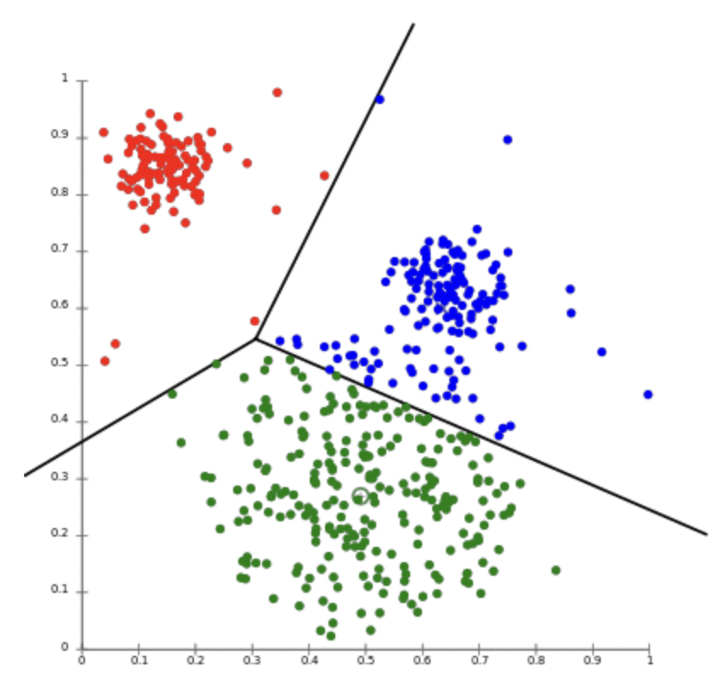
Making a Prediction with K-Means
Assigning a cluster to a new sample
Find the total distance between a sample and a centroid by summing the euclidean distance between each feature and the centroid
Assign the sample to the cluster with the smaller distance

Slide 14
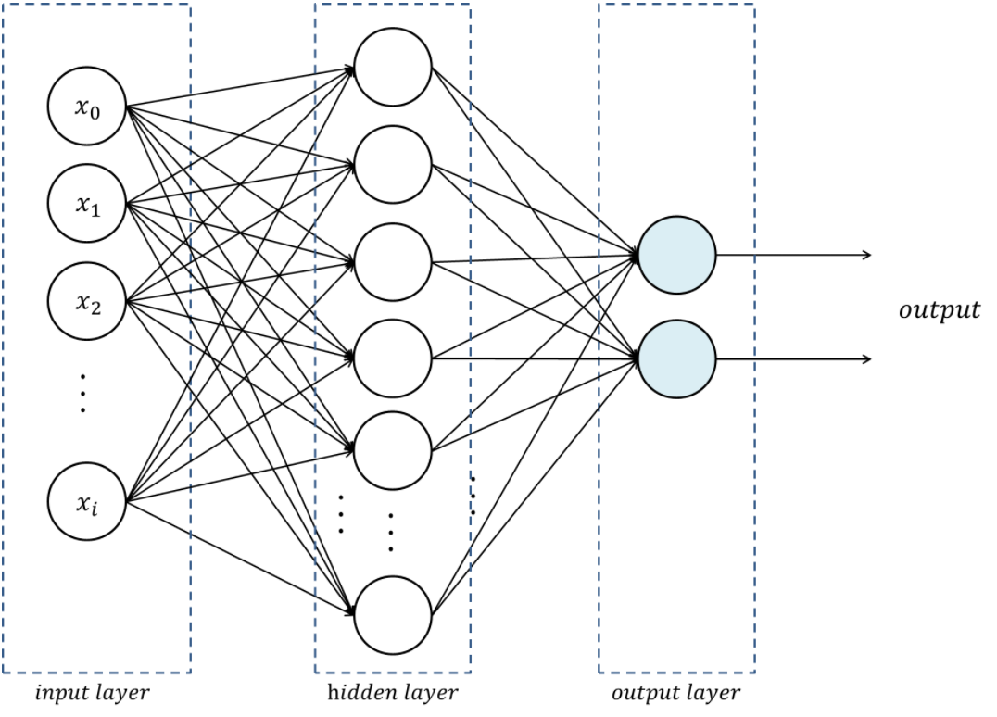
Multi-layered Neural Network
How the neural network is initialized
How the neural network is trained
Forward propagation
Backward propagation
Optimization

Slide 15
Neural Network Layer Sizes
[0]
[1]
[2]
30
32
2

Slide 16
Initializing the Neural Network
Initialize W1, the weights between the input layer and the hidden layer.
Initialize b1, the biases at the hidden layer
Initialize W2, the weights between the hidden layer and the output layer.
Initialize b2, the biases at the output layer.

Slide 17
Training the Neural Network
Defining hyperparameters:
Learning rate
Number of epochs
Batch size

Slide 18

Rectified Linear Unit (ReLU) Function

Slide 19

Softmax Function

Slide 20
Training the Neural Network
Given:
X as the training data
Forward propagation:
Z1 = X • W1 + b1
A1 = ReLU(Z1)
Z2 = A1 • W2 + b2
A2 = Softmax(Z2)

Slide 21
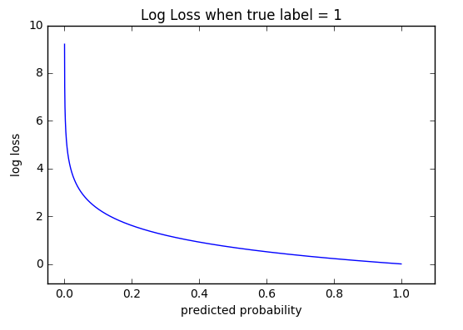
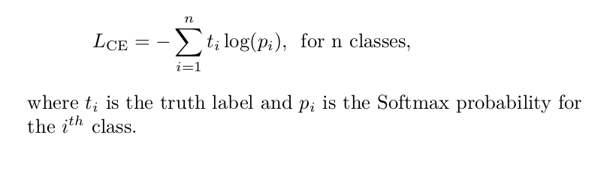
Cross Entropy Loss Function

Slide 22
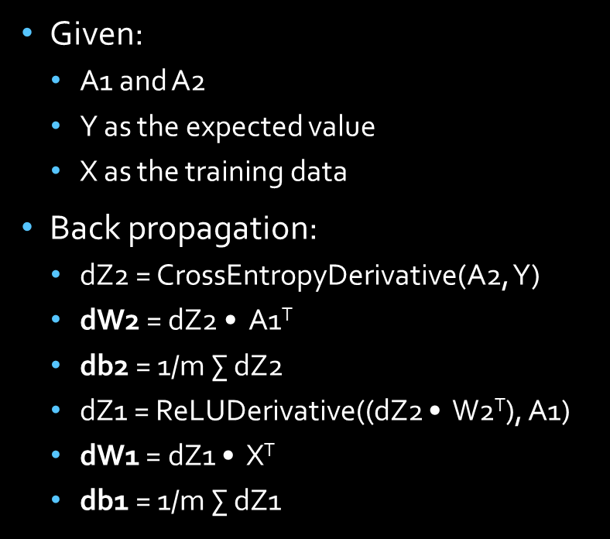
Training the Neural Network
Given:
A1 and A2
Y as the expected value
X as the training data
Back propagation:
dZ2 = CrossEntropyDerivative(A2, Y)
dW2 = dZ2 • A1^{T}
db2 = 1/m $\text{∑}$ dZ2
dZ1 = ReLUDerivative((dZ2 • W2^{T}), A1)
dW1 = dZ1 • X^{T}
db1 = 1/m $\text{∑}$ dZ1

Slide 23
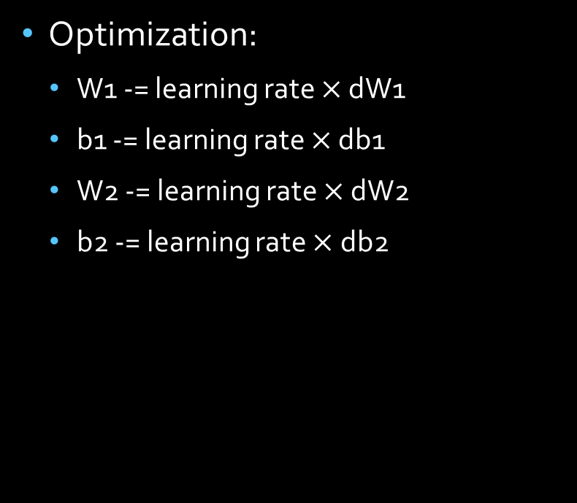
Training the Neural Network
Optimization:
W1 -= learning rate $×$ dW1
b1 -= learning rate $×$ db1
W2 -= learning rate $×$ dW2
b2 -= learning rate $×$ db2

Slide 24
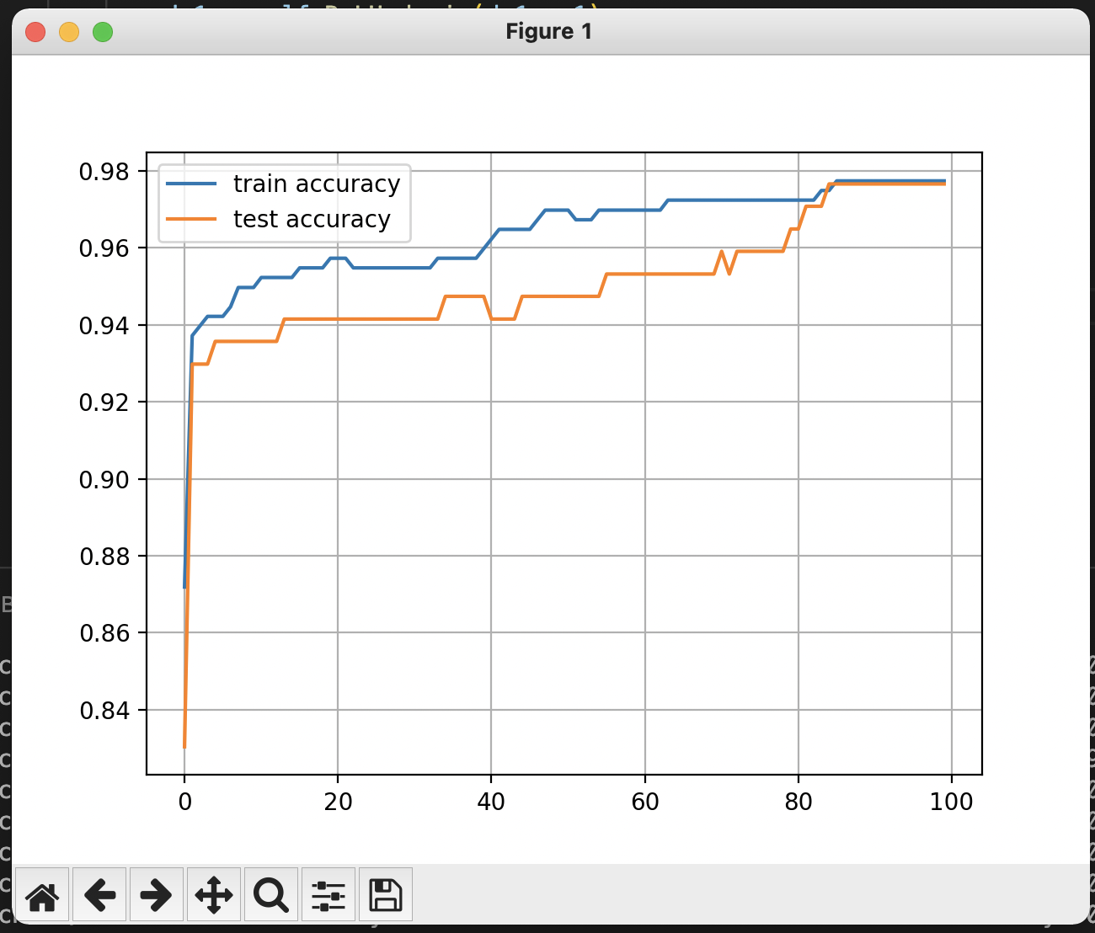
Training the Neural Network
Accuracies as a function of epoch number

Slide 25
Results
Metric | Naïve Bayes | K-means | Multi-layered NN
Accuracy | 95% | 94% | 99%
Precision | 95% | 100% | 99%
Recall | 90% | 76% | 98%
False negative | 10% | 24% | 2%
F1 | 93% | 86% | 99%

Slide 26
References
[1] Jui-Ying, Kuan-Yung, Ken Ying-Kai, Po-Hsin, Geoffrey, & Tzung-Chi. (2019). Detection and classification of breast tumours using mask R-CNN on sonograms.Medicine.

Slide 27
Thank you!

